Slide 1
CSE291 – Introduction to Software Engineering (FALL 2022)
Sequence Diagrams

Slide 2
Interaction Models
All systems involve interaction of some kind…
This can be user interaction, which involves user inputs and outputs
Interaction between the system being developed and other systems
Or interaction between the components of the system
Use case modeling, which is mostly used to model interactions between a system and external actors (users or other systems).
Sequence diagrams are used to model interactions between system components, although external agents may also be included.

Slide 3
Sequence Diagrams
Describe the flow of messages, events, actions between objects.
Show time sequences that are not easily depicted in other diagrams.
Typically used to understand the logical flow of system.
Emphasis on time ordering!

Slide 4
Sequence Diagram Key Parts
In a sequence diagram, objects and actors are aligned along the top of the diagram.
Object1 name:classname
Object 2name:classname
Actors
Objects

Slide 5
Sequence Diagram Key Parts
Labeled arrows indicate operations; the sequence of operations is from top to bottom.
The axes in a sequence diagram:
– horizontal: Represents that which object/participant is acting
– vertical: Represents time sequence

Slide 6
Sequence Diagram Notation
Object1
Object 2
Lifelines
Identify the existence of the object over time.

Slide 7
Sequence Diagram Notation
Object 1
Object 2
Activations
Indicate when an object is performing an action

Slide 8
Sequence Diagram Notation
Object 1
Object 2
message
Messages
Indicate the communications between objects

Slide 9
Sequence Diagram Notation
Object 1
Object 2
message
message
Sequence
Vertical position signifies sequence – earlier messages appear nearer the top.

Slide 10
Developing Sequence Diagrams
There are four main steps to draw sequence diagram:
Identify the relevant objects involved in the computation
Establish the role of each object
Identify the controller
Decide messages between objects

Slide 11
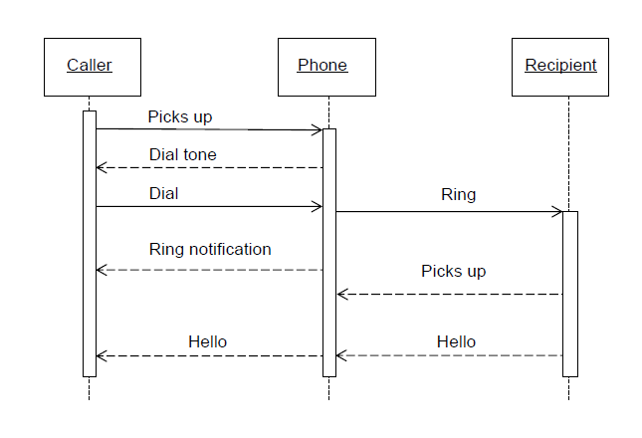
Sequence Diagram (make a phone call)

Slide 12
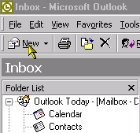
A Simpler Example - Sending an email

Slide 13
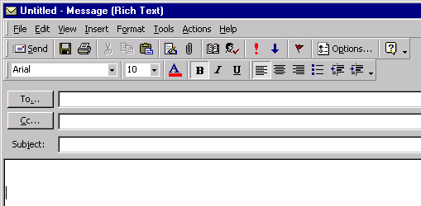
E-mail Interface

Slide 14
Working From a Scenario
Sending an email
1. Press “New ” email icon
2. Enter person’s name in “To” section
3. Type subject
4. Type contents
5. Press Send button
6. System looks up email address in address book
7. System submits the email to the email server

Slide 15
Starting The Diagram
If this is an interactive scenario, we always have an actor driving it

Slide 16
Add Objects
The first interaction is with the icon bar, which we can treat as an
object

Slide 17
Add Message
The user talks to the icon bar

Slide 18
Label The Communication
Remember that actors can only communicate with interface objects such as screens, menus and icon bars.

Slide 19
The icon bar has some work to do.
It creates an email page.
Now the user can see the email page and use it.

Slide 20
The next three steps are filling in the details on the email page

Slide 21
The User then clicks Send

Slide 22
Now consider how to do the sending
We can choose to get the email page to look up the email address from an address book object

Slide 23
The arrow allows information to return
So we don’t need to put a return arrow with the email address going back to the email page

Slide 24
We can choose to get the email page to submit the email to the email server

Slide 25
And if we think carefully, the email page always closes after the send.

Slide 26
Now we go through and change the messages to operations on the object

Slide 27
And so on, all the way through

Slide 28
And now we have found our objects, and the operations on them
So we drag them onto a class diagram

Slide 29
Exercise
Consider the following scenario and draw sequence diagram for online book shop.
“Online customer can search book catalog, view description of a selected book, add book to shopping cart, do checkout”.

Slide 30
Sequence Fragment
A sequence fragment is represented as a box that frames a section of interactions between objects in a sequence diagram.
It is used to show complex interactions such as alternative flows and loops in a more structured way.
On the top left corner of the fragment sits an operator. This – the fragment operator – specifies what sort of a fragment it is.

Slide 31
Alternative Fragment
The alternative fragment is used when a choice needs to be made between two or more message sequences. It models the “if then else” logic.
The alternative fragment is represented by a large rectangle or a frame; it is specified by mentioning ‘alt’ inside the frame’s name box
To show two or more alternatives, the larger rectangle is then divided using a dashed line

Slide 32
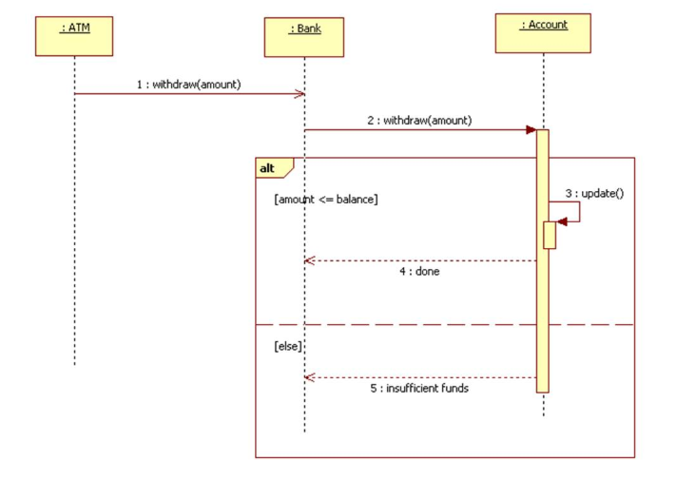
An alternative fragment provides several guarded alternative fragments

Slide 33
Option Fragment
The option fragment is used to indicate a sequence that will only occur under a certain condition, otherwise, the sequence won’t occur. It models the “if then” statement.
Similar to the alternative fragment, the option fragment is also represented with a rectangular frame where ‘opt’ is placed inside the name box.
Unlike the alternative fragment, an option fragment is not divided into two or more operands. Option’s guard is placed at the top left corner.

Slide 34
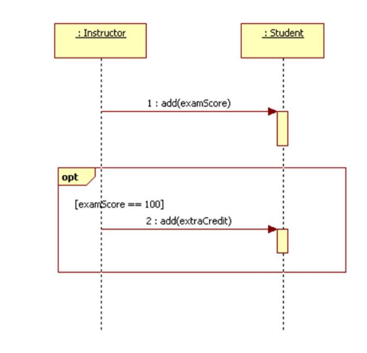
An optional fragment is only executed if some guard condition is true

Slide 35
Exercise
Draw a sequence diagram that represents the process of exam conduction described in the case study below:
Before the exam conduction, the instructor first informs the students of the exam date and the syllabus (material) included as part of exam. The instructor then prepares the exam paper. The instructor then gets the exam paper copied from staff to produce enough copies for the students, and later the instructor hands over the exam paper to the students on the designated time and location.
The students are required to write their answers against questions listed in the exam paper. Students should hand in their solution sheet to the instructor before time runs out.
The instructor then gives the solution sheet of students to the Teaching Assistance (TAs), along with sample solutions to each question, and gets them to mark it. TAs then return solution Sheet to instructor after marking. She then records all marks and inform result to the students.

Slide 36
Home Task (Reading Assignment)
Loop Fragment
Reference fragment

Slide 37
Chapter Reading
Chapter 5, System Modeling,
Software Engineering by Ian Sommerville

